Slide 1
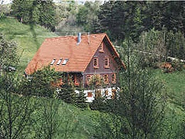
Mein Haus
Donnerstag, den 12. März
Objective: To add more detail to house descriptions and write about what our house is like.

Slide 2

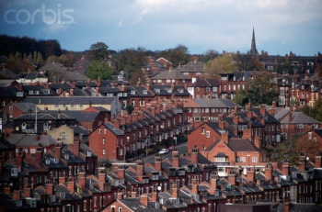


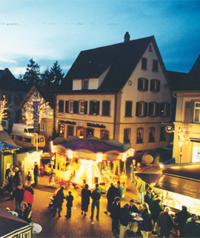
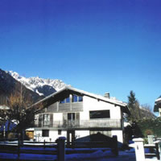
Ich wohne……
auf dem Land
am Stadtrand
in der Stadt
an der Küste
in den Bergen
in einem Dorf

Slide 3
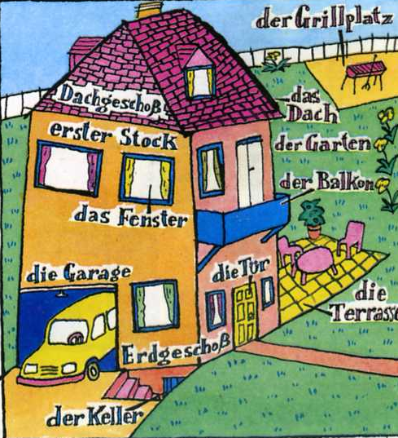
Mein Haus hat………………
In meinem Haus gibt es ………………
einen Grillplatz
Dachgeschoß
ein
Dach
erster Stock
einen Garten
einen Balkon
ein Fenster
eine Garage
eine Tur
eine
Terasse
Erdgeschoß
einen Keller

Slide 4
Was beschreibe ich?
Draw the features of a house that I am describing!

Slide 5
Was beschreibe ich?
Draw the house that I am describing!

Slide 6
DIE FARBEN
ORANGE
ROSA
ROT
BRAUN
GRAU
GRÜN
WEISS
GELB
BLAU
LILA
SCHWARZ

Slide 7













Slide 8
Mein ideales Haus
Extra! Mein ideales Haus
Write a paragraph (at least 3 sentences) to say what your house is like.
Include:
What kind of house it is.
Where it is.
What size and colour it is.
What it looks like/what it has in it.
You’ve won the lottery and can buy a new house! Write a paragraph (at least 3 sentences) to say what your new house would be like.
Include:
What kind of house it would be.
Where it would be.
What size and colour it would be.
What it would look like/what it would have in it.

Slide 9
Was hast du diese Woche gelernt?
5 types of house
4 features of a house
3 locations
2 sizes
1 colour

